Slide 1
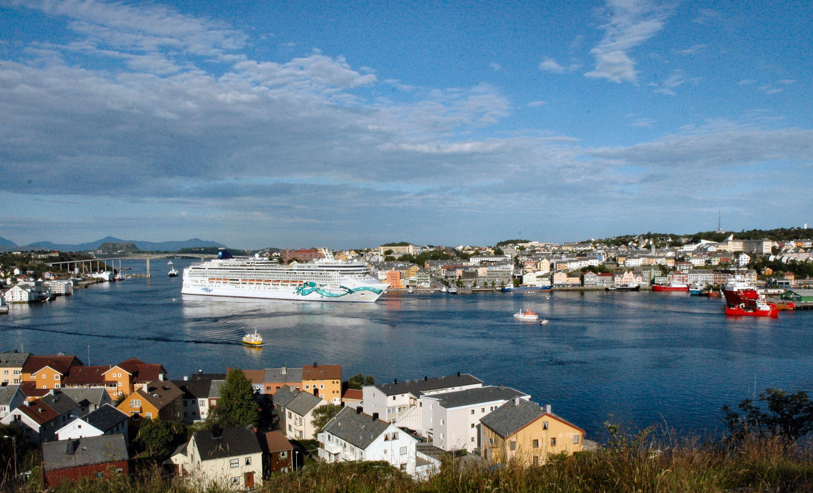
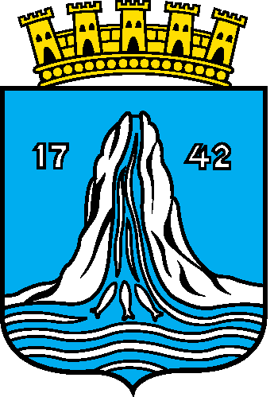
Inter- Municipal Cooperation
in the region of Nordmøre,
Norway

Slide 2
A short presentation of myself:
Name: Maritta B. Ohrstrand
Headmaster of an elementary school
Educated teacher of Special education
Experience as member of a municipal council
for more than 30 years
Mayor of the municipality of Frei for 8 years
Deputy mayor of Kristiansund for 4 years
Chairman of the board of SMO regional level for 8 years, member of the national board for 4 years and many other boards for years………

Slide 3
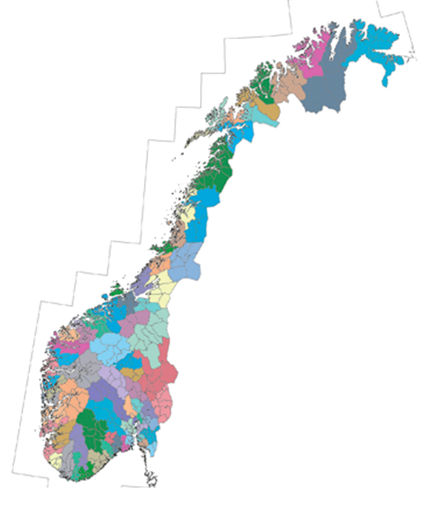
NORWAY
20 Counties
430 Municipalities
- How about the future?
79 Regional Councils
Regional Councils
in Norway
Notes:
Frå regjeringen:
http://www.regjeringen.no/nn/dep/krd/Dokument/proposisjonar-og-meldingar/stortingsmeldingar/20042005/stmeld-nr-25-2004-2005-/12.html?id=407434
3.1 Allment interkommunalt samarbeid (regionråd o. l.)
Praktisk talt alle kommunar i Noreg deltar i eit breitt, interkommunalt samarbeid med nabokommunar i form av regionråd. Telemarksforsking har gjennomført fleire undersøkingar av omfanget av regionråd, og har nytta desse kriteria for at ei samarbeidsordning skal bli kalla regionråd:
Det er eit politisk samarbeidsorgan mellom nabokommunar der minimum ordførarane er med.
Organet har eigne vedtekter.
Organet har mange slags saker som arbeidsfelt (er ikkje sektororgan).

Slide 4
Challenges of small municipalities in Norway
How to take care of the broad variety of tasks in small municipalities?
How to recruit the right persons – amount and qualifications?
Too few inhabitants with higher education (especially women at the age of 20-39)

Slide 5
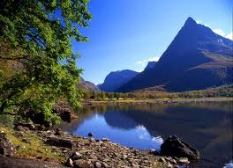
…continued:
Less people in rural areas (centralization)
Building a strong and attractive region for young and well educated families
Adequate transportation and infrastructure between living areas and jobs

Slide 6
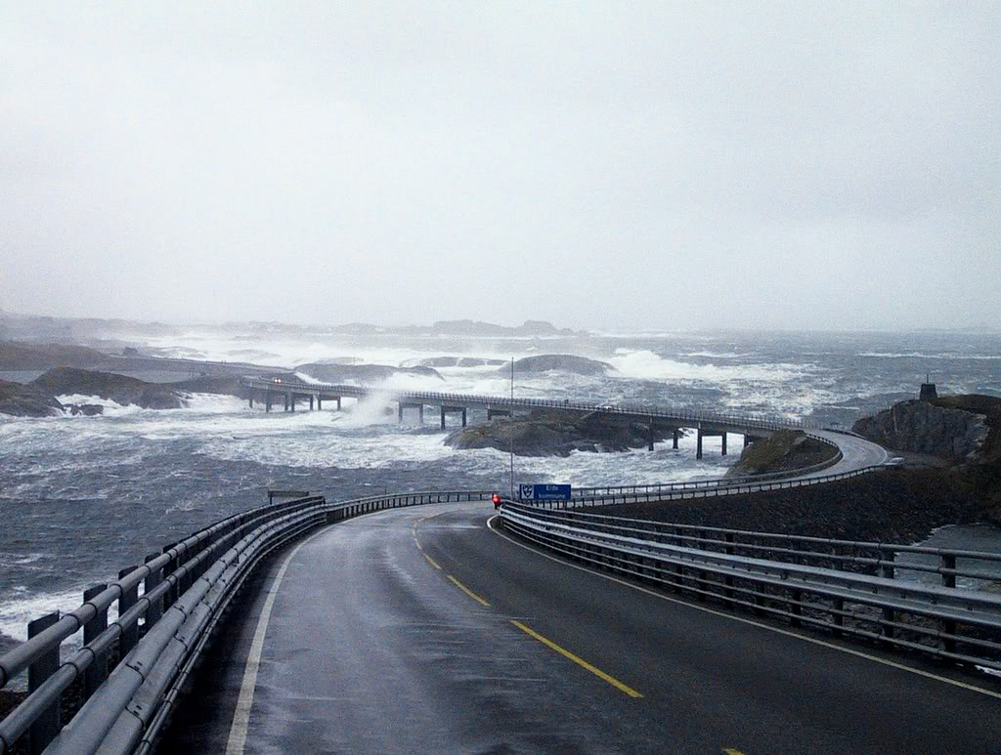
The solution for the region of Nordmøre?

Slide 7
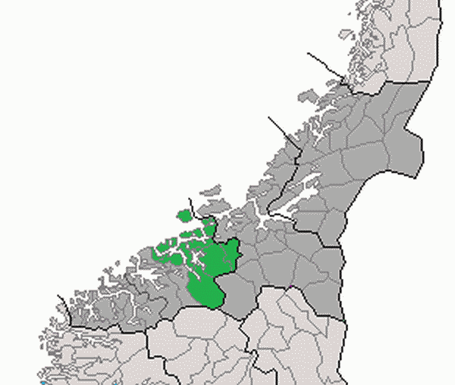
Nordmøre:
62 000 inhabitants
11 municipalities:
Averøy : 5.600
Aure : 3.500
Gjemnes : 2.500
Eide : 3.500
Tingvoll : 3.100
Smøla : 2.200
Halsa : 1.600
Rindal : 2.000
Kristiansund : 24.200
Sunndal : 7.000
Surnadal : 6.000
= ORKidé

Slide 8
ORKidé:
Formalized cooperation between 11 municipalities at Nordmøre – established in 1990 ( - in 1990 there were 13 . We have had 2 amalgamations )
Mayor and Chief Executive from each municipality meet at least three times a year, bringing important questions to the table. Meet in the different municipalities.
Discuss common challenges and possibilities:
Responding to national hearings
Projects concerning the whole area
Regional plans

Slide 9
Consensus
The principle of consensus is the way of working to get things done.
The core challenge:
If we can not agree, we do not get things done! Consensus is what gives strength!

Slide 10
Practical work
Common goals and strategies
4 year plan
Service cooperation across borders
Municipalities pay according to amount of inhabitants for the membership
Projects are financed separately

Slide 11
Projects:
ICT ORKidé
Strategic plan of commerce for the whole area
Child Protection office for three municipalities
Areal planning of the coastal areas
Infrastructural projects (roads and tunnels)

Slide 12
NORDMØRE – a united region to meet the future!

