Slide 1
Forum for Local Action on Energy Efficient Behaviour
Energy Behaviour Forum

Slide 2

Strong Support for Local and Regional Authorities in Energy Efficiency Interventions
Changing how we consume energy can deliver immediate gains in Europe’s energy resilience while tackling climate change and environmental degradation.
Behavioural measures have long been part of EU and national energy-saving strategies, with various initiatives supporting local and regional implementation. In recent years, behaviour change has gained stronger recognition as essential to reducing energy use to sustainable levels.
The Energy Behaviour Forum will enable pooling of efforts on behavioural measures at the local or regional level and encourage
the adoption of best practices across Europe.

Slide 3
The Project in a Nutshell
The aim of the Energy Behaviour Forum - is to establish a digital online platform to advance and share energy efficient behavioural practices and to support local and regional authorities in integrating behavioural insights into the design and implementation of energy efficiency interventions.
The Energy Behaviour Forum is funded by the EU Commission and developed by a consortium led by VITO Flemish Institute for Technological Research and its 12 partners. Project was launched in March of 2025, and the first phase of the project will run till the end of 2026.
  Besides VITO other partners are Energy Saving Trust (UK), Energy Cities network, Motiva Services Oy (Finland), the Council of European Municipalities and Regions (CEMR), DNV (the Netherlands), Oeko-Institute (Germany), the Austrian Energy Agency (AEA) (Austria), ADENE ─ Portuguese Energy Agency (Portugal), the Centre for Renewable Energy Sources & Energy Saving (CRES) (Greece), Netherlands Enterprise Agency (RVO)(the Netherlands), and the Slovak Innovation and Energy Agency (SIEA)(Slovakia).
Further information, please contact:
info@eebforum.eu

Slide 4
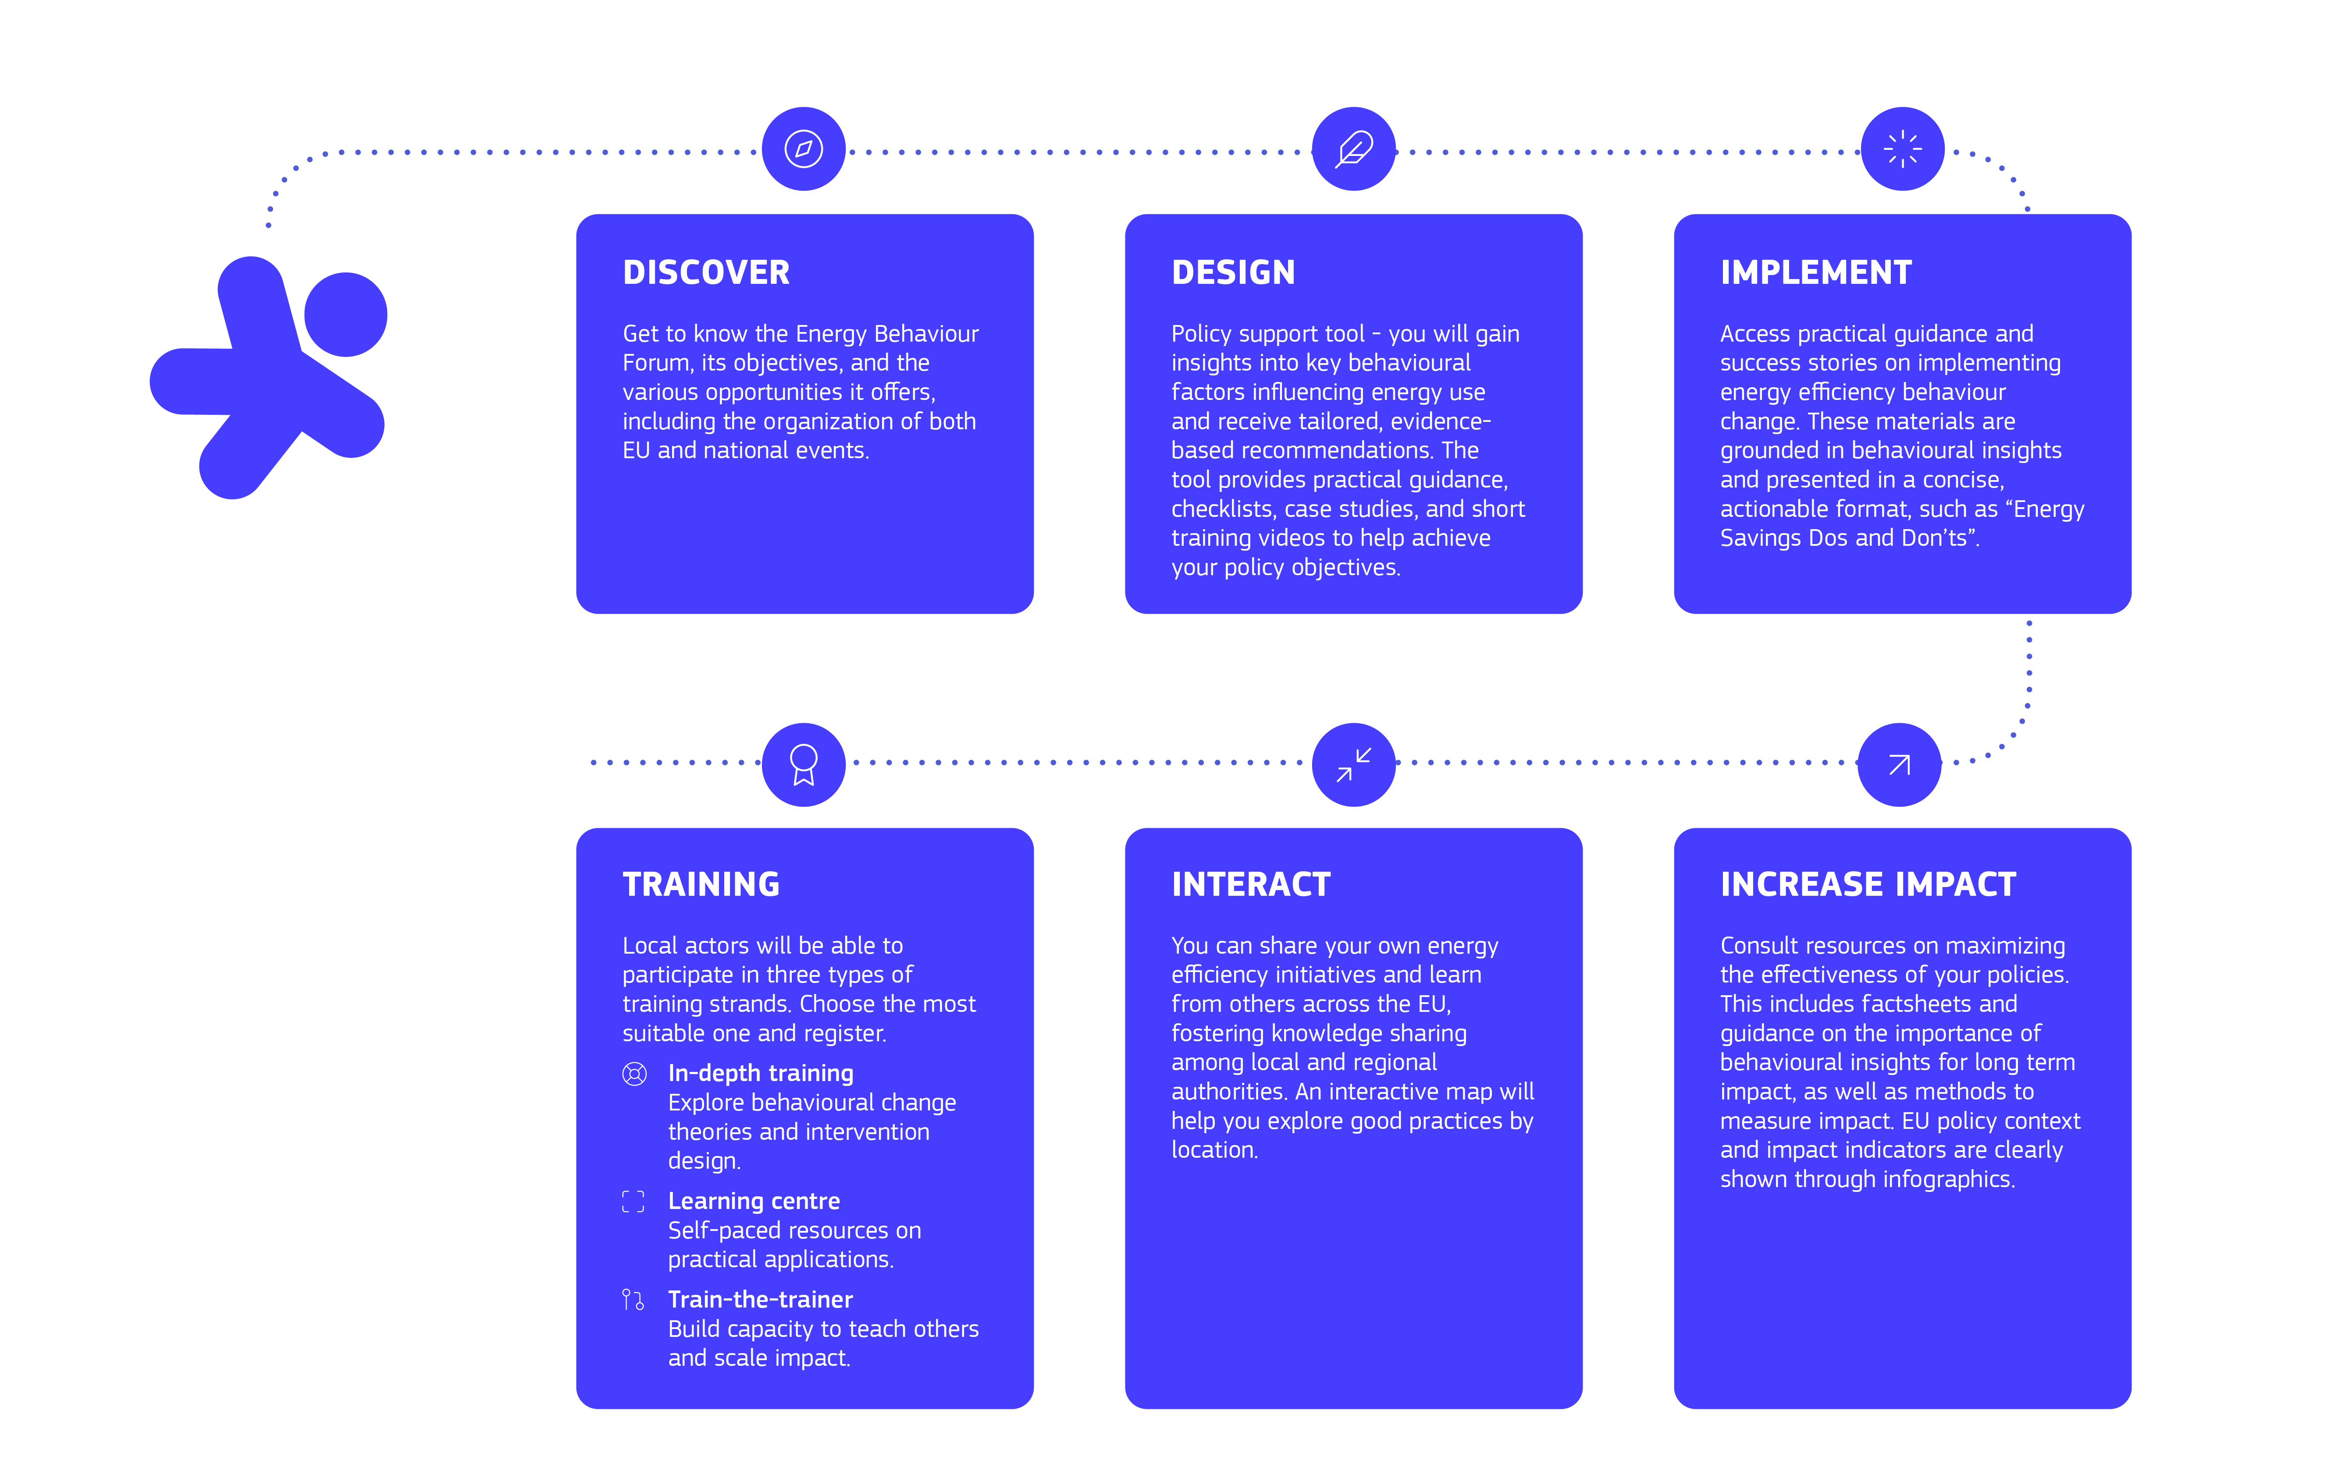
What can you expect from us?

Slide 5

Develop your skills on effective interventions at local level
The Energy Behaviour Forum helps you to develop your skills in formulating and executing energy efficiency interventions, encompassing short-term, medium-term, and long-term strategies, specifically targeting engagement with citizens and private sector stakeholders.
Interactive Knowledge Sharing Hub disseminates best practices, practical guidance, tools, and insights into the impact of behavioral measures.
Capacity-building and training activities are developed for different levels and study modes: live in-depth and train the trainers session and online course for self-learning.
Sharing experiences with peers: local and regional authorities can exchange experiences related to energy efficiency projects and awareness campaigns.

Slide 6

The Friends of the Energy Behaviour Forum
The Energy Behaviour Forum will engage and cooperate with relevant European stakeholders and initiatives to foster a coordinated approach between them.
It will create synergies between the different initiatives and all parties will benefit from cooperation and visibility.
Initiatives and organisations are encouraged to join the Energy Behaviour Forum.

Slide 7


Stay connected with Energy Behaviour Forum
Newsletter
Social media:
@energy4europe
#EnergyBehaviourForum
Subscribe to the Energy Behaviour Forum Newsletter for up-to-date information on Forum events, training sessions and other activities.
Subscribe
Website (launching in August)
The Energy Behaviour Forum website will launch in August 2025 offering materials, tools and training for local and regional authorities and other organisations involved in planning and executing projects, initiatives and campaigns for boosting energy efficiency.

Slide 8
Thank You!

